Slide 1
Overview of AI LISP and other Al programming languages
Course Name: Artificial Intelligence
Course code: CSE-403 [ SECTION - A ]

Slide 2
Outlines
Difference between Human and Machine Intelligence
Speech and Voice Recognition
Agents in Artificial Intelligence
PEAS Representation
What is Ideal Rational Agent?
Types of AI Agents
Agent Environment in AI
AI (Artificial Intelligence) computer programming languages
Artificial intelligence, Machine Learning, and Deep Learning
What are the different domains/Subsets of AI?

Slide 3
Difference between Human and Machine Intelligence
Humans perceive by patterns whereas the machines perceive by set of rules and data.
Humans store and recall information by patterns, machines do it by searching algorithms. For example, the number 40404040 is easy to remember, store, and recall as its pattern is simple.
Humans can figure out the complete object even if some part of it is missing or distorted; whereas the machines cannot do it correctly.
Speech and Voice Recognition
These both terms are common in robotics, expert systems and natural language processing. Though these terms are used interchangeably, their objectives are different.
speech Recognition | Voice Recognition
The speech recognition aims at understanding and comprehending WHAT was spoken. | The objective of voice recognition is to recognize WHO is speaking.
It is used in hand-free computing, map, or menu navigation. | It is used to identify a person by analysing its tone, voice pitch, and accent, etc.
Machine does not need training for Speech Recognition as it is not speaker dependent. | This recognition system needs training as it is person oriented.
Speaker independent Speech Recognition systems are difficult to develop. | Speaker dependent Speech Recognition systems are comparatively easy to develop.

Slide 4
Agents in Artificial Intelligence
An AI system can be defined as the study of the rational agent and its environment. The agents sense the environment through sensors and act on their environment through actuators. An AI agent can have mental properties such as knowledge, belief, intention, etc.
What is an Agent?
An agent can be anything that perceiveits environment through sensors and act upon that environment through actuators. An Agent runs in the cycle of perceiving, thinking, and acting. An agent can be:
Human-Agent: A human agent has eyes, ears, and other organs which work for sensors and hand, legs, vocal tract work for actuators.
Robotic Agent: A robotic agent can have cameras, infrared range finder, NLP for sensors and various motors for actuators.
Software Agent: Software agent can have keystrokes, file contents as sensory input and act on those inputs and display output on the screen.
Hence the world around us is full of agents such as thermostat, cellphone, camera, and even we are also agents.
Before moving forward, we should first know about sensors, effectors, and actuators.

Slide 5
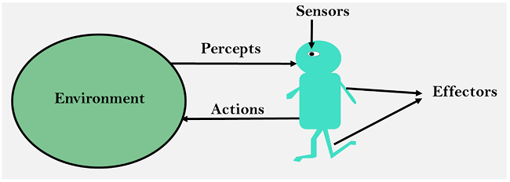
Sensor: Sensor is a device which detects the change in the environment and sends the information to other electronic devices. An agent observes its environment through sensors.
Actuators: Actuators are the component of machines that converts energy into motion. The actuators are only responsible for moving and controlling a system. An actuator can be an electric motor, gears, rails, etc.
Effectors: Effectors are the devices which affect the environment. Effectors can be legs, wheels, arms, fingers, wings, fins, and display screen.
Intelligent Agents:
An intelligent agent is an autonomous entity which act upon an environment using sensors and actuators for achieving goals. An intelligent agent may learn from the environment to achieve their goals. A thermostat is an example of an intelligent agent.
Following are the main four rules for an AI agent:
Rule 1: An AI agent must have the ability to perceive the environment.
Rule 2: The observation must be used to make decisions.
Rule 3: Decision should result in an action.
Rule 4: The action taken by an AI agent must be a rational action.

Slide 6
Structure of an AI Agent
The task of AI is to design an agent program which implements the agent function. The structure of an intelligent agent is a combination of architecture and agent program. It can be viewed as:
Agent = Architecture + Agent program
Following are the main three terms involved in the structure of an AI agent:
Architecture: Architecture is machinery that an AI agent executes on.
Agent Function: Agent function is used to map a percept to an action.
f:P* → A
Agent program: Agent program is an implementation of agent function. An agent program executes on the physical architecture to produce function f.
PEAS Representation
PEAS is a type of model on which an AI agent works upon. When we define an AI agent or rational agent, then we can group its properties under PEAS representation model. It is made up of four words:
P: Performance measure
E: Environment
A: Actuators
S: Sensors
Here performance measure is the objective for the success of an agent's behavior.

Slide 7
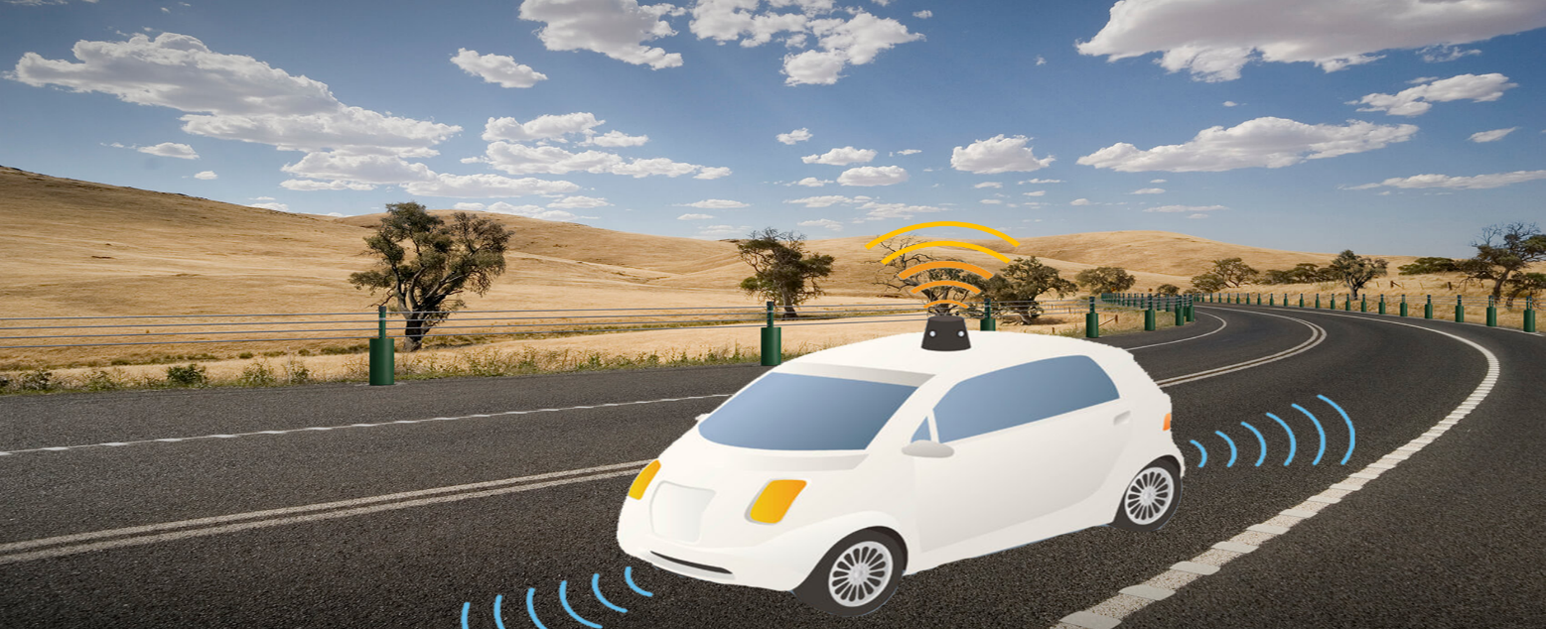
PEAS for self-driving cars:
Let's suppose a self-driving car then PEAS representation will be:
Performance: Safety, time, legal drive, comfort
Environment: Roads, other vehicles, road signs, pedestrian
Actuators: Steering, accelerator, brake, signal, horn
Sensors: Camera, GPS, speedometer, odometer, accelerometer, sonar.

Slide 8
Agent | Performance measure | Environment | Actuators | Sensors
1.Medical Diagnose | Healthy patient Minimized cost | Patient Hospital Staff | Tests Treatments | Keyboard (Entry of symptoms)
2.Vacuum Cleaner | Cleanness Efficiency Battery life Security | Room Table Wood floor Carpet Various obstacles | Wheels Brushes Vacuum Extractor | Camera Dirt detection sensor Cliff sensor Bump Sensor Infrared Wall Sensor
3. Part -picking Robot | Percentage of parts in correct bins. | Conveyor belt with parts, Bins | Jointed Arms Hand | Camera Joint angle sensors.

Slide 9
What is Ideal Rational Agent?
An ideal rational agent is the one, which is capable of doing expected actions to maximize its performance measure, on the basis of −
Its percept sequence
Its built-in knowledge base
Rationality of an agent depends on the following −
The performance measures, which determine the degree of success.
Agent’s Percept Sequence till now.
The agent’s prior knowledge about the environment.
The actions that the agent can carry out.
A rational agent always performs right action, where the right action means the action that causes the agent to be most successful in the given percept sequence. The problem the agent solves is characterized by Performance Measure, Environment, Actuators, and Sensors (PEAS).
The Structure of Intelligent Agents
Agent’s structure can be viewed as −
Agent = Architecture + Agent Program
Architecture = the machinery that an agent executes on.
Agent Program = an implementation of an agent function.

Slide 10
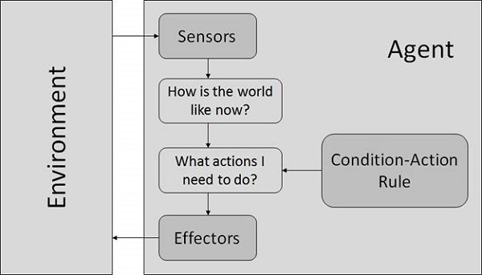
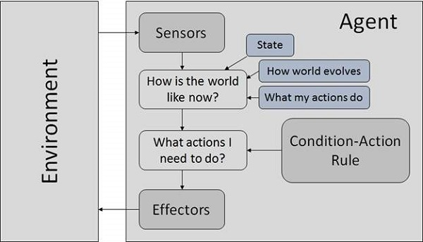
Types of AI Agents
Simple Reflex Agents
They choose actions only based on the current percept.
They are rational only if a correct decision is made only on the basis of current precept.
Their environment is completely observable.
Condition-Action Rule − It is a rule that maps a state (condition) to an action.
Model Based Reflex Agents
They use a model of the world to choose their actions. They maintain an internal state.
Model − knowledge about “how the things happen in the world”.
Internal State − It is a representation of unobserved aspects of current state depending on percept history.
Updating the state requires the information about −
How the world evolves.
How the agent’s actions affect the world.

Slide 11
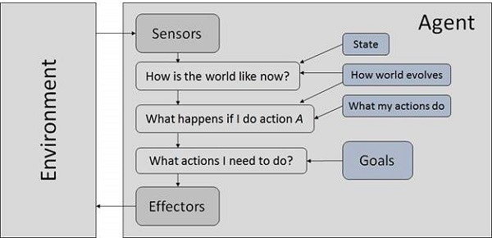
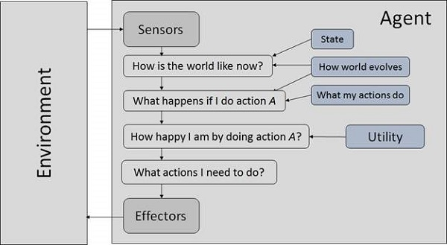
Goal Based Agents
They choose their actions in order to achieve goals. Goal-based approach is more flexible than reflex agent since the knowledge supporting a decision is explicitly modeled, thereby allowing for modifications.
Goal − It is the description of desirable situations.
Utility Based Agents
They choose actions based on a preference (utility) for each state.
Goals are inadequate when −
There are conflicting goals, out of which only few can be achieved.
Goals have some uncertainty of being achieved and you need to weigh likelihood of success against the importance of a goal.

Slide 12
Agent Environment in AI
An environment is everything in the world which surrounds the agent, but it is not a part of an agent itself. An environment can be described as a situation in which an agent is present.
The environment is where agent lives, operate and provide the agent with something to sense and act upon it. An environment is mostly said to be non-feministic.
Features of Environment/Properties of Environment
As per Russell and Norvig, an environment can have various features from the point of view of an agent:
Fully observable vs Partially Observable
Static vs Dynamic
Discrete vs Continuous
Deterministic vs Stochastic
Single-agent vs Multi-agent
Episodic vs sequential
Known vs Unknown
Accessible vs Inaccessible

Slide 13
Discrete / Continuous − If there are a limited number of distinct, clearly defined, states of the environment, the environment is discrete (For example, chess); otherwise it is continuous (For example, driving).
Observable / Partially Observable − If it is possible to determine the complete state of the environment at each time point from the percepts it is observable; otherwise it is only partially observable.
Static / Dynamic − If the environment does not change while an agent is acting, then it is static; otherwise it is dynamic.
Single agent / Multiple agents − The environment may contain other agents which may be of the same or different kind as that of the agent.
Accessible / Inaccessible − If the agent’s sensory apparatus can have access to the complete state of the environment, then the environment is accessible to that agent.
Deterministic / Non-deterministic − If the next state of the environment is completely determined by the current state and the actions of the agent, then the environment is deterministic; otherwise it is non-deterministic.
Episodic / Non-episodic − In an episodic environment, each episode consists of the agent perceiving and then acting. The quality of its action depends just on the episode itself. Subsequent episodes do not depend on the actions in the previous episodes. Episodic environments are much simpler because the agent does not need to think ahead.
Known vs Unknown
Known and unknown are not actually a feature of an environment, but it is an agent's state of knowledge to perform an action.
In a known environment, the results for all actions are known to the agent. While in unknown environment, agent needs to learn how it works in order to perform an action.
It is quite possible that a known environment to be partially observable and an Unknown environment to be fully observable.

Slide 14
Today, there are two of the most common AI (Artificial Intelligence) computer programming languages are LISP and Prolog. They are designed with two distinct programming paradigms, and LISP is a functional language, whereas Prolog is a formal language. The main difference between these languages is that LISP was considered a computation model based on the theory of recursive functions. In contrast, the prolog includes a set of formal logic specifications that employ first-order predicate calculus. Below are the top five programming languages that are widely used for the development of Artificial Intelligence:
Python
Java
Lisp
R
Prolog
What is LISP?
LISP is an abbreviation for "LISt Processing". Lisp is a computer programming language family. It is a functional computer language that was created and used by John McCarthy and the MIT group in 1960. It was primarily utilized in the computer science research initiatives, such as those involving artificial intelligence (including theorem proving, intelligent systems, robotics, natural language processing, etc.).
The most distinguishing characteristic of LISP language from other languages is the equivalence of forms between program and data, which means that LISP can execute data structures as programs, and programs may be altered as data. Furthermore, despite iteration, it is more dependent on recursion as a control mechanism (looping).
LISP generates an interactive environment for running its programs. In an interactive environment, the main program alters the form, and the user inserts the main program as a sequence of expressions to be inspected at the terminal. It doesn't utilize block structure or any other type of complex syntactic organization, and it utilizes calls to communicate with the other functions running simultaneously.

Slide 15
What is Prolog?
Prolog is a logic computer language that is utilized in artificial intelligence and computational linguistics. It is a member of the logic computer language family. Prolog is a declarative language in which computations are carried out by querying the relations that are specified as rules and facts. Prolog was created in 1970, and it is one of the oldest logic programming languages and one of the most common AI programming languages today (along with Lisp). Although it is a free language, there are numerous commercial variants accessible.
One of the first logic computer languages was Prolog. It aids the users in several tasks, including term rewriting, type systems, theorem proving, expert systems, natural language processing, and automated planning. It also aids in the development of graphical user interfaces (GUI), administrative apps, and networked applications. Furthermore, it is appropriate for rule-based logical inquiries, including template filling, database searching, and voice control systems.
Features | LISP | Prolog
Definition | It is the second-oldest high-level computer language after FORTRAN, and it has evolved significantly since its inception. | It is a logical computer language related to artificial intelligence and computational linguistics.
Language Types | It is functional programming. | It is logic programming.
Program | LISP programs include functions, conditional evaluation, loops, recursion, and iteration. | It includes directed control search, patterns, loops, and backtracking.
Based on | It is based on functions in a global environment. | It is based on rules and facts.
Data Types | It has symbolic and numeric atoms, lists and list structure, and property and association lists. | It has symbolic and numeric atoms, predicates, lists, and list structures.
Transmitting data | In LISP, data transit in program function returns, local and global variables binding, and parameter passing by value are all supported. | It binds the data or numbers with the variable via unification.
Variable | It has lexical or dynamic scoping of free variables, bound variables, and local variables using Let blocks. | Its variable scope scoping is confined to a single rule or fact.
Supported Paradigms | It supports the functional, reflective, procedural, and Meta paradigms. | It supports the logical computing paradigm.

Slide 16
How Artificial intelligence, Machine Learning, and Deep Learning differ from each other?
The difference between AI, ML, and Deep Learning is given in the below table:
Artificial Intelligence | Machine Learning | Deep Learning
The term Artificial intelligence was first coined in the year 1956 by John McCarthy. | The term ML was first coined in the year 1959 by Arthur Samuel. | The term DL was first coined in the year 2000 Igor Aizenberg.
It is a technology that is used to create intelligent machines that can mimic human behavior. | It is a subset of AI that learns from past data and experiences. | It is the subset of machine learning and AI that is inspired by the human brain cells, called neurons, and imitates the working of the human brain.
AI completely deals with structured, semi-structured data. | ML deals with structured and semi-structured data. | Deep learning deals with structured and unstructured data.
It requires a huge amount of data to work. | It can work with less amount of data compared to deep learning and AI. | It requires a huge amount of the data compared to the ML.
The goal of AI is to enable the machine to think without any human intervention. | The goal of ML is to enable the machine to learn from past experiences. | The goal of deep learning is to solve the complex problems as the human brain does, using various algorithms.

Slide 17
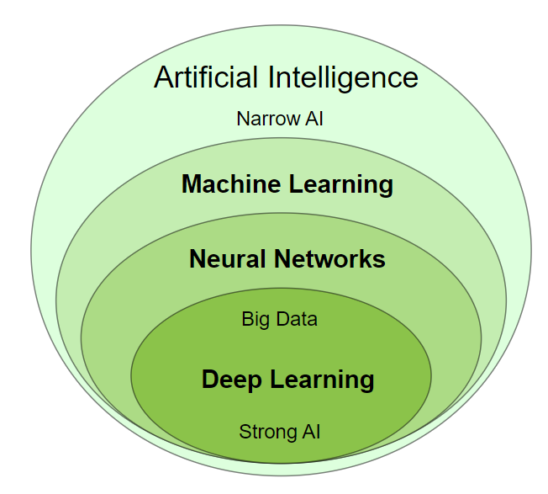
What are the different domains/Subsets of AI?
AI covers lots of domains or subsets, and some main domains are given below:
Machine Learning
Deep Learning
Neural Network
Expert System
Fuzzy Logic
Natural Language Processing
Robotics
Speech Recognition

